Slide 1
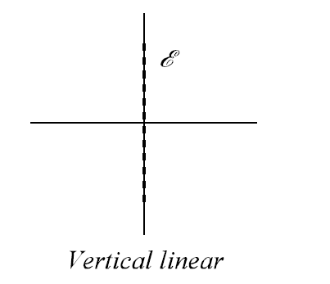
Dept. of Communication Engineering College of Engineering- University of Diyala Lecture No.: 3 part(3)
3rd year Class
Antenna Theory and Design Lec. Jinan N. Shehab
Wave polarization:- an important property of an EM wave.
Wave polarization ia a quantity describting the arientation of the electric field E.
Consider a plane wave Traveling out of the page (+ Z-direction) and in general has x & y component:-
Ex= E1 sin (wt – βZ) Ey= E2 sin (wt – βZ+δ)
Where:- E1 = amplitude of wave linearly polarized in x direction E2 = amplitude of wave linearly polarized in y direction δ = time-phase angle by which Ey leads Ex .
If the E vector is vertical, the wave is vertical polarizaed and requires a vertical antenna to radiate it, while the magnetic field H being horizontal.
If the E vector is horizontal, the wave is horizontal polarized and requires a horizontal antenna to radiate it.
Circular or (elliptical) polarization is a combination of vertical and horizontal polarization.
From above note we can divided polarization into:- 1- Linear polarization:-
a- vertical linearly polarized (in y- direction)as a function of time and position:- E1=0, E2=1, Z=0, δ=0
1
wt | E | wt | E
0 | 0 | 180 | 0
30 | 0.5 | 210 | -0.5
45 | 0.707 | 240 | -0.866
60 | 0.886 | 270 | -1
90 | 1 | 300 | -0.866
120 | 0.866 | 330 | -0.5
150 | 0.5 | 360 | 0
-1
b- Horizontal linearly polarized (in x-direction)as a function of time and position:- E1=1, E2=0, Z=0, δ=0

Slide 2
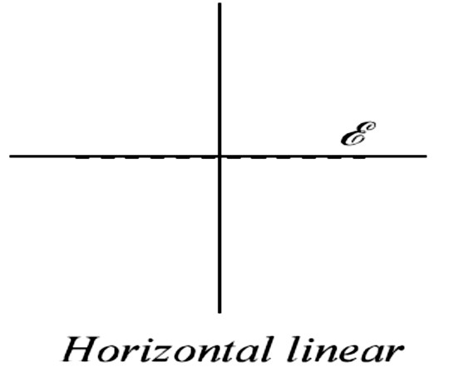
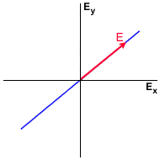
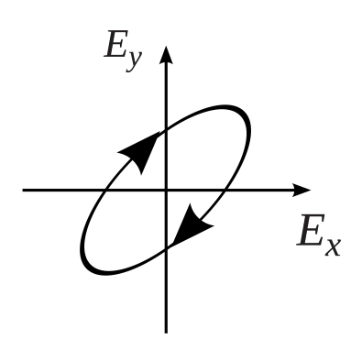
Dept. of Communication Engineering College of Engineering- University of Diyala Lecture No.: 3 part(3)
3rd year Class
Antenna Theory and Design Lec. Jinan N. Shehab
-1
1
c- This wave is said to be linearly polarized in the plane at angle 45.
E1=1, E2=1, Z=0, δ=0
wt | Ex | Ey | 2 _{+ 𝐸}2 ET=√𝐸� �
0 | 0 | 0 | 0
30 | 0.5 | 0.5 | 0.707
45 | 0.707 | 0.707 | 1
60 | 0.886 | 0.886 | 1.224
90 | 1 | 1 | 1.414
120 | 0.886 | 0.866 | 1.224
150 | 0.5 | 0.5 | 0.707
180 | 0 | 0 | 0
210 | -0.5 | -0.5 | 0.707
240 | -0.866 | -0.866 | 1.224
270 | -1 | -1 | 1.414
300 | -0.866 | -0.866 | 1.224
330 | -0.5 | -0.5 | 0.707
360 | 0 | 0 | 0
2- Elliptically polarization:-
a- The wave is said to be elliptically polarized at E rotates as a function of time:- E1=1, E2=1, Z=0, δ=45
wt | Ex | Ey | 2 _{+ 𝐸}2 ET=√𝐸� �
0 | 0 | 0.707 | 0.707
30 | 0.5 | 0.966 | 1.087
45 | 0.707 | 1 | 1.224
60 | 0.886 | 0.966 | 1.31
90 | 1 | 0.707 | 1.224
120 | 0.886 | 0.258 | 0.923
135 | 0.707 | 0 | 0.707
150 | 0.5 | -0.258 | 0.562
180 | 0 | 0.707 | 0.707

Slide 3
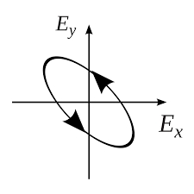
Dept. of Communication Engineering College of Engineering- University of Diyala Lecture No.: 3 part(3)
3rd year Class
Antenna Theory and Design Lec. Jinan N. Shehab
210 | -0.5 | -0.966 | 1.087
240 | -0.866 | -0.966 | 1.31
270 | -1 | -0.707 | 1.224
300 | -0.866 | -0.258 | 0.923
330 | -0.5 | 0.258 | 0.563
360 | 0 | 0.707 | 0.707
b- The wave is said to be Anti-clock wise elliptically polarized:- E1=1, E2=1, Z=0, δ=-45
wt | Ex | Ey | 2 _{+ 𝐸}2 ET=√𝐸� �
0 | 0 | -0.707 | 0.707
30 | 0.5 | -0.258 | 0.563
45 | 0.707 | 0 | 0.707
60 | 0.886 | 0.966 | 1.31
90 | 1 | 0.707 | 1.306
120 | 0.886 | 0.966 | 1.31
135 | 0.707 | 1 | 1.306
150 | 0.5 | 0.966 | 1.087
180 | 0 | 0.707 | 0.707
210 | -0.5 | 0.2588 | 0.563
240 | -0.866 | -0.258 | 0.923
270 | -1 | -0.707 | 1.224
300 | -0.866 | -0.966 | 1.31
330 | -0.5 | -0.966 | 1.086
360 | 0 | -0.707 | 0.707
c- This type of polarization is called circular polarization in this type of polarization, E rotate as a function of time in a circule form:-
d- E1=1, E2=1, Z=0, δ=90.
wt | Ex | Ey | 2 _{+ 𝐸}2 ET=√𝐸� �
0 | 0 | 1 | 1
30 | 0.5 | 0.866 | 1
45 | 0.707 | 0.707 | 1
60 | 0.886 | 0.57 | 1
90 | 1 | 0 | 1
120 | 0.886 | -0.5 | 1
135 | 0.707 | -0.707 | 1
150 | 0.5 | -0.866 | 1
180 | 0 | -1 | 1
210 | -0.5 | -0.866 | 1
240 | -0.866 | -0.5 | 1

Slide 4
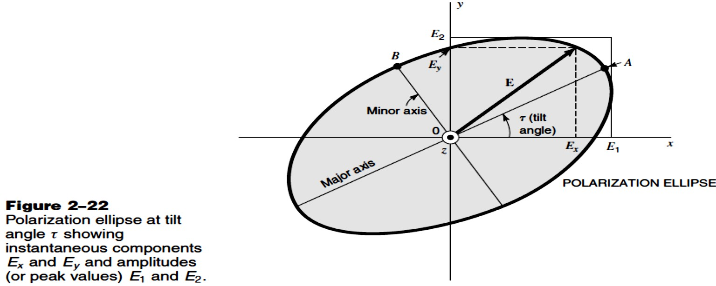
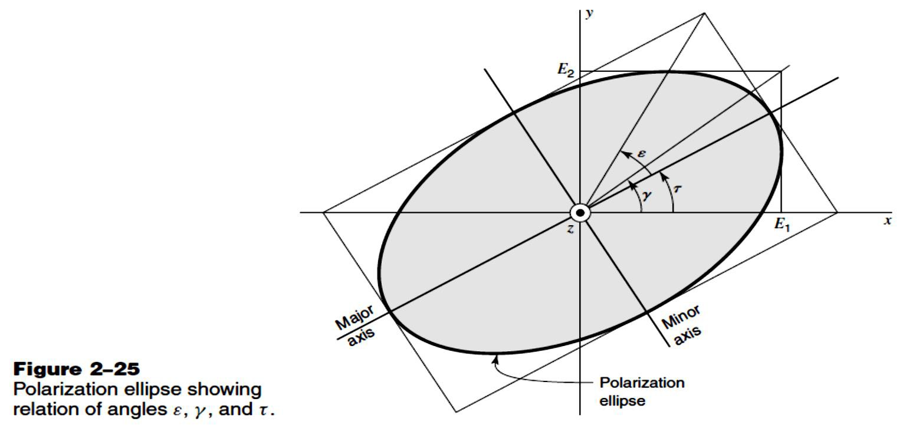
Dept. of Communication Engineering College of Engineering- University of Diyala Lecture No.: 3 part(3)
3rd year Class
Antenna Theory and Design Lec. Jinan N. Shehab
270 | -1 | 0 | 1
300 | -0.866 | 0.5 | 1
330 | -0.5 | 0.866 | 1
360 | 0 | 1 | 1
Axial Ratio(AR):- is the ratio of the major to minor axis of the polarization ellipse.
𝐸₂
��= _{𝐸}
1
The instantanous total vector field E:-
𝐸= �₁ sin(𝑤� − ��)�̂ + 𝐸₂ sin(𝑤� − ��+ �)�̂
However for circular polarization:-
+
�₁ = 𝐸₂, � = ₋90 , 𝑎�� ��= 1
Tilt angle (𝝉 ) :- is the angle between the X-axis and the intersection components EX and Ey.

Slide 5
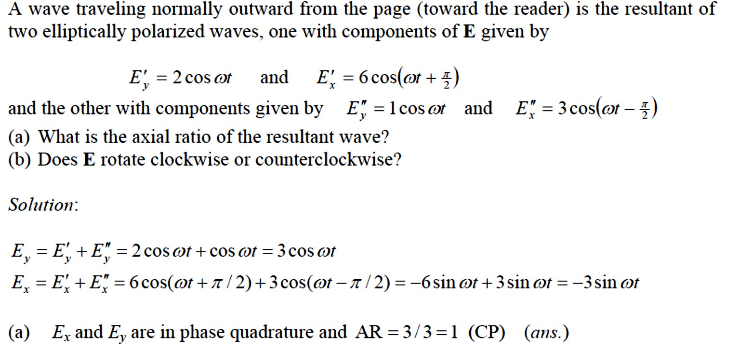
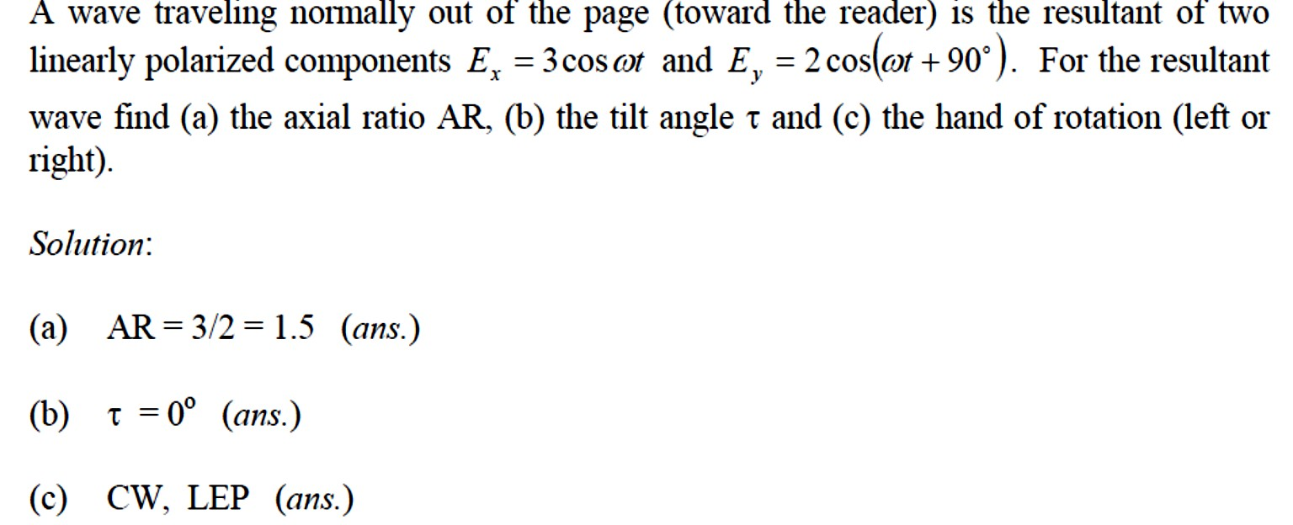
Dept. of Communication Engineering College of Engineering- University of Diyala Lecture No.: 3 part(3)
3rd year Class
Antenna Theory and Design Lec. Jinan N. Shehab
𝐸₂
� = �𝑎�⁻¹
𝑤ℎ�� 0 ≤ � ≤ 90
�₁
�𝑎�2𝜏= �𝑎�2� ����
�
1 ≤ ��≤ ∞, ��= �
+ve AR means left hand (clockwise).
-ve AR means right hand. The tilt angle 𝜏is :-
1
𝜏= ₂ �𝑎�
₋₁ 2�₁𝐸₂ ����
𝐸² − 𝐸²
1 2

Slide 6
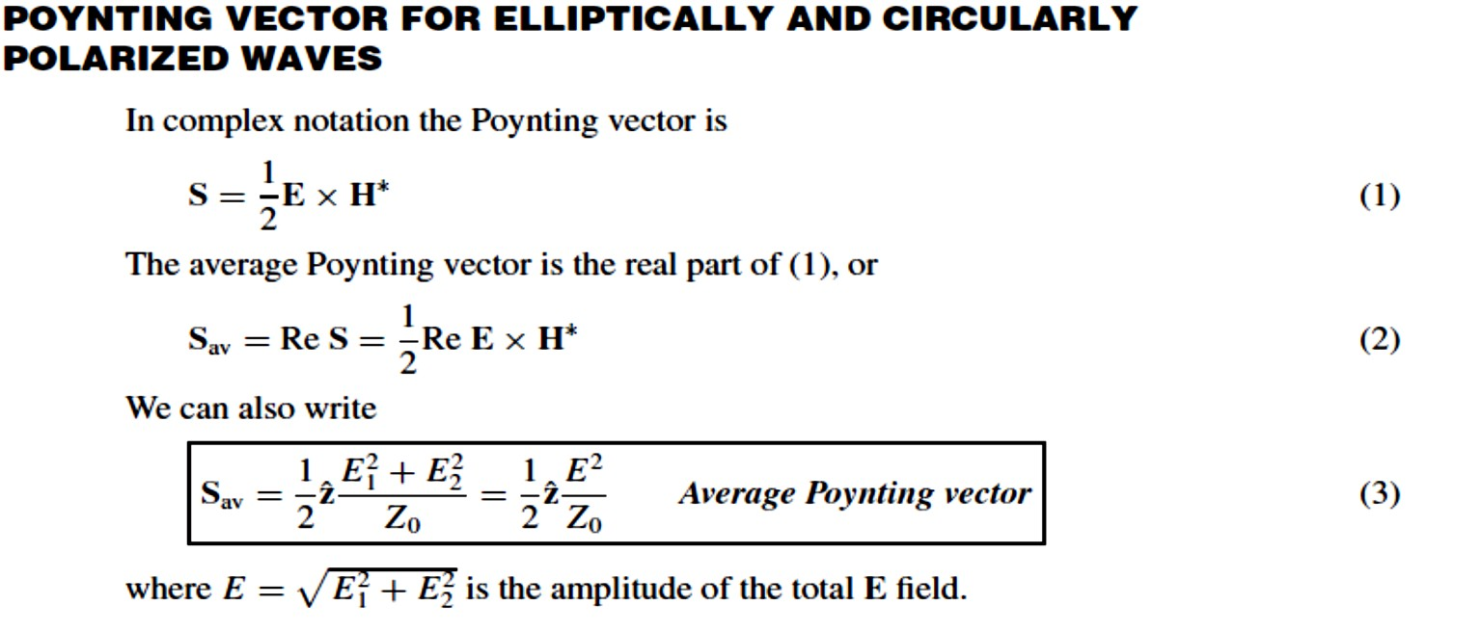
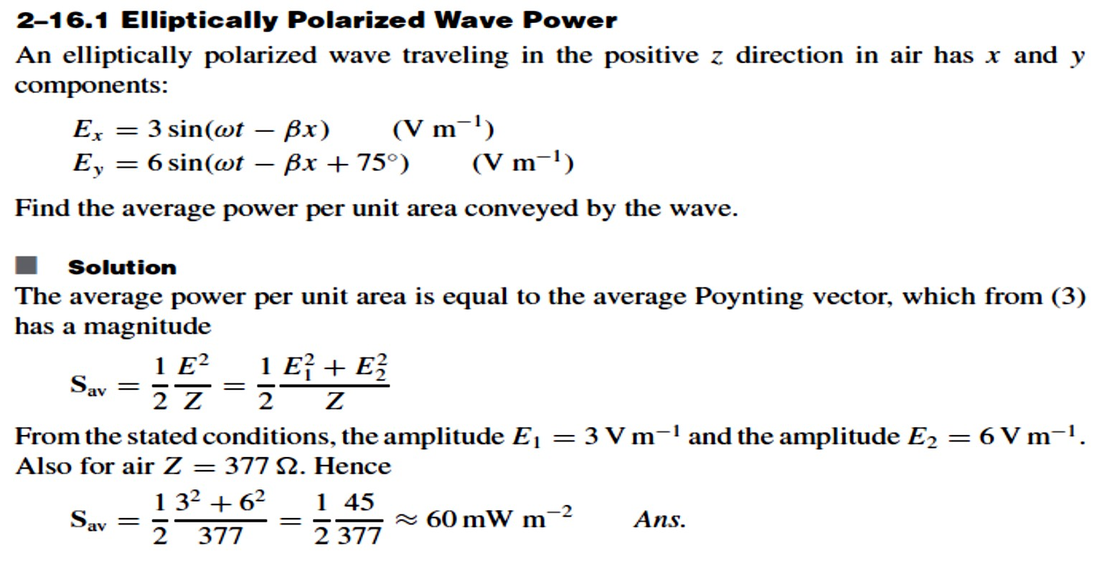
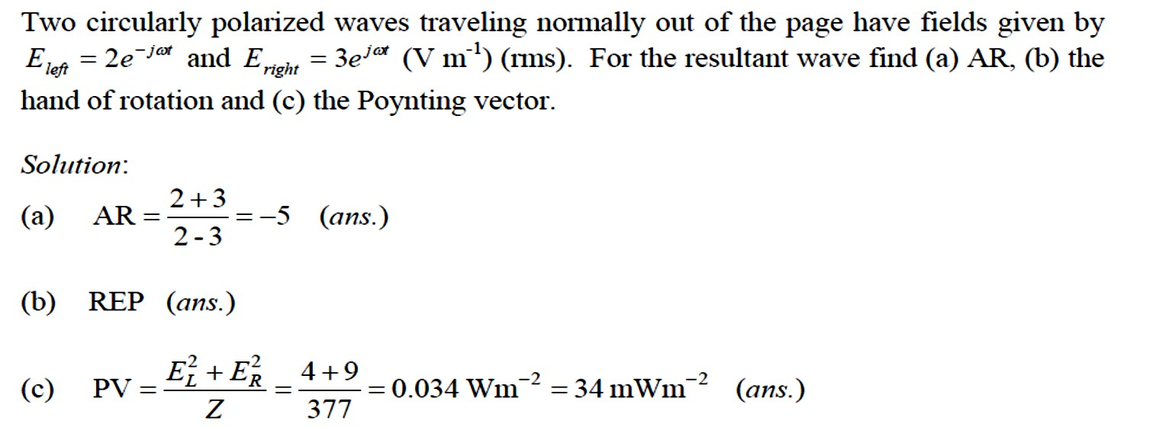
Dept. of Communication Engineering College of Engineering- University of Diyala Lecture No.: 3 part(3)
3rd year Class
Antenna Theory and Design Lec. Jinan N. Shehab

Slide 7
Dept. of Communication Engineering College of Engineering- University of Diyala Lecture No.: 3 part(3)
3rd year Class
Antenna Theory and Design Lec. Jinan N. Shehab
Effective Area/ Effective Aperture/ Capture Area:-

